Slide 1

Life Expectancy Around the World during 1952-2007
By Hanna Bohannon

Slide 2
Overview
Highs & Lows of GDP Per Captia in 1952 and 2007
Graph and Variations
Summary and Conclusion

Slide 3
Countries with the Lowest & Highest per capita GDP in 1952 and 2007
1952 and 2007
Egypt had the lowest gdpPerCap in both 1952 and 2007.
2007
Switzerland had the highest gdpPerCap in 1952. While the United States had the highest gdpPerCap in 2007.

Slide 4
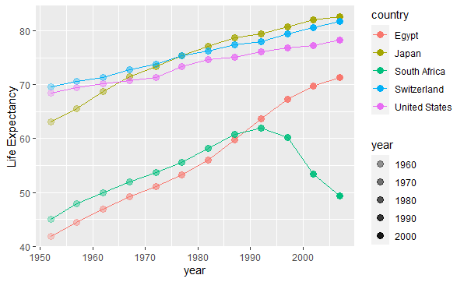
Graph and Variations
If we look here, we’ll see that the median years for life expectancy for each country was the early 90s, and we began to see a decline in South Africa by ten years in life expectancy. This was largely due to apartheid, war, and HIV/AIDS.
Japan however seems to have the secret to living a long healthy life, closely followed by Switzerland with them reaching a little over 80 years of age in life expectancy in 2007.

Slide 5
Summary and Conclusion
When it comes to life expectancy around the world, there’s numerous factors that affect the growth and aging of the population in different countries. Such as lifestyle, politics, health, and climate control. All of those combined can drastically affect a country in a blink of an eye.

